Slide 1
Understanding Stacks in Data Structures

Slide 2
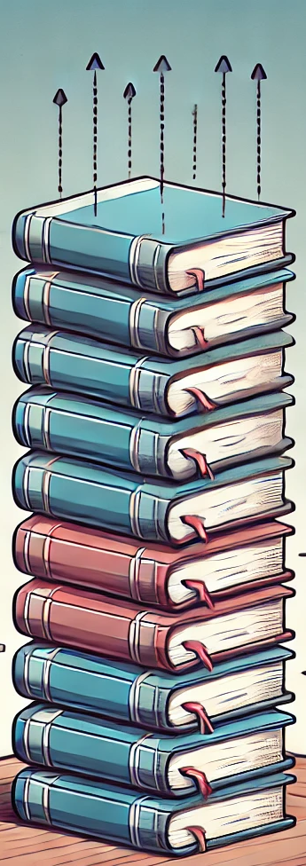
What is a Stack?
A stack is like a stack of books.
The last book you put on the top is the first one you take off when you need one.
This is called Last In, First Out, or LIFO for short.
It means the last thing you add is the first thing you remove.

Slide 3
Basic Operations in a Stack
A stack has four main operations:
Push
Pop
Peek
IsEmpty

Slide 4
Push Operation
Think of putting books on a small table.
If you put the book 'A' first, then book 'B', and finally book 'C' on top, the last book you put down, book 'C', is the first one you can pick up.
This is what we call a push operation in a stack

Slide 5
Pop Operation
If you want to take a book off the table where books 'A', 'B', and 'C' are stacked with 'C' on top, you start with removing book 'C’.
This is the pop operation in a stack. It means taking the top book off the stack, so after you remove 'C', book 'B' becomes the new top book that you can take next.

Slide 6
Peek Operation
If you just want to see which book is on top of the stack without taking it off, you look at book 'C’.
This is the peek operation in a stack. It allows you to check the top book, 'C', without removing it from the stack.
So, you know 'C' is there, but it stays on top of the stack.

Slide 7
Is Empty Operation
If you want to check if there are any books left on the table, you look to see if the stack is empty. This is the 'IsEmpty' operation.
If there are no books on the table, it means the stack is empty. If you still see books like 'A' or 'B', then it's not empty.
This operation helps you know whether there’s anything to pick up or not.

Slide 8
Real World Examples
Plates in a Cafeteria: Think of a stack of plates in a cafeteria. You always take the top plate, and new plates are added on top-this is a practical example of a stack in action.
Books on a Desk: When you stack books on your desk, the last book you place on top is the first one you'll pick up when you need one. This mimics the stack's Last In, First Out (LIFO) principle.

Slide 9
Real World Examples
Chairs Stacked Up: In many schools or event halls, chairs are often stacked one on top of another. The last chair you stack is the first one you’ll take down to use.
Pancakes on a Plate: When cooking pancakes, each new pancake is placed on top of the stack on the plate. When you serve them, you usually take the top pancake first, which is the last one cooked.

Slide 10
Real World Examples
Undo Button in Software: When you edit a document or image, the undo button acts like a stack. Each change you make is "pushed" onto the stack. When you hit undo, you "pop" the last change off the stack to revert it.
Browser History: The back button in a web browser follows the stack structure. Each site you visit is pushed onto a stack. When you press the back button, you go back in the order of the sites visited, popping them off the stack one by one.

Slide 11
Solving Problems with Stacks Reversing a String
Problem: Reverse the string "HELLO" using a stack.
Steps:
1. Push each character onto the stack: H -> E -> L -> L -> O.
2. Pop each character off to form the reversed string: O -> L -> L -> E -> H.
Solution: "OLLEH"

